Slide 1
H.aHKBox Chassis
&
Hardware Interface Communications
Adam Stammer
Under the Direction of Dr. Carl Ferkinhoff

Slide 2
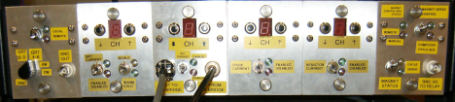
Motivations
Obsolete Internal Chips
Multiplexer Readout Rate Limit
Dependent On PC

Slide 3
Abstract Goals
Open Source
Modular-Card System
Cheap
Versatile
Design Steps
Prototyping Daughtercard (P-Card)
Backplane
ZEUS2 Daughtercards
Chassis and Accompanying Components
Communication Programming
Goals

Slide 4
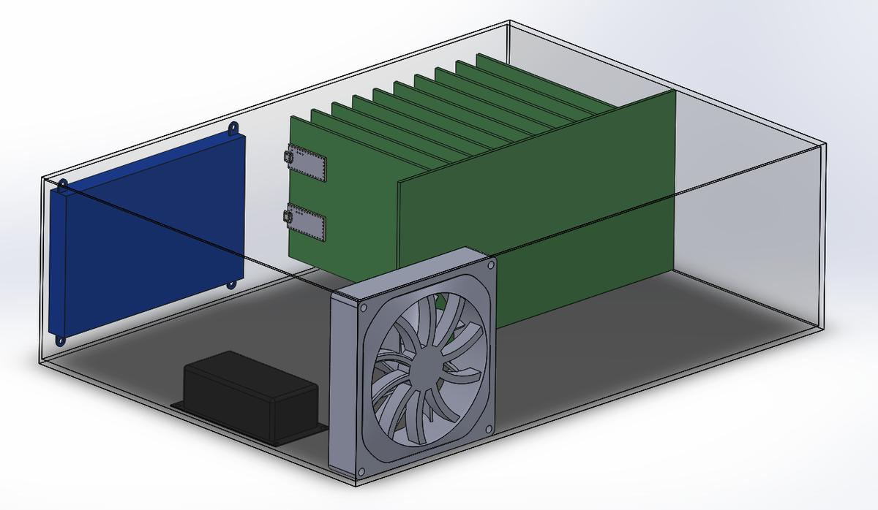
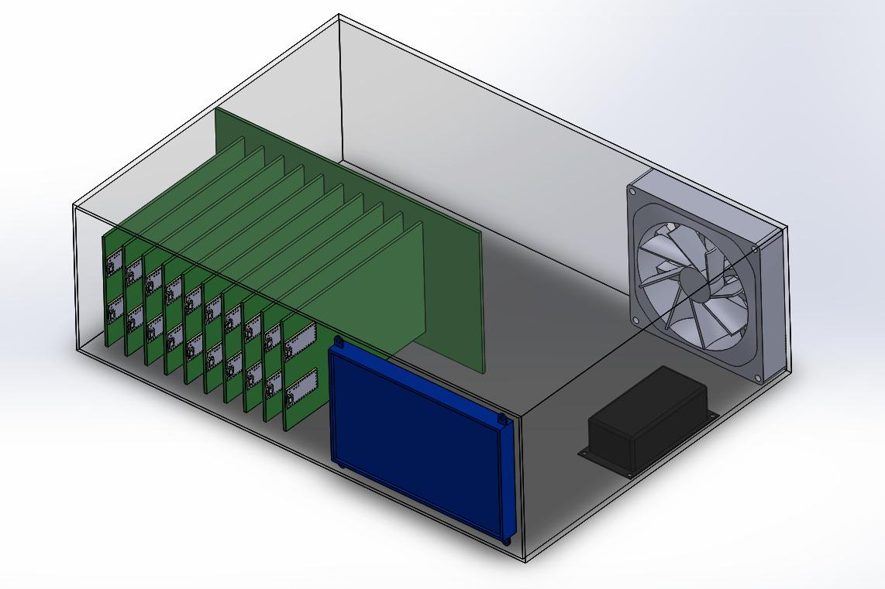
Draft Model
Blue = touch screen
Black = power supply
Grey = cooling fan
Green = circuit boards (big is the bus, and slam are the cards)

Slide 5
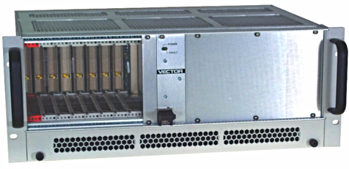
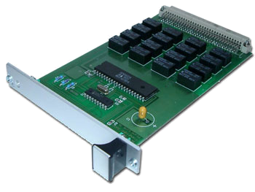
Device | Processor | RAM/ Storage | Other | Software | Ref.
Raspberry Pi 3 $39.95 | 64-bit 1.2 GHz ARM | 1 GB/ 32GB | 40GPIO, SPI, I2C, HDMI, 4 - USB, Ethernet, Serial | Debian Linux | [5]
Teensy 3.2 $19.80 | 72 MHz ARM Cortex-M4 | 64KB/ 256 KB | 34 GPIO, 21 ADC (13-Bit), Serial (3), SPI, I2C (2), | Arduino IDE | [6]
Similar cases and cards as the H.aHK Box as found commercially.

Slide 6
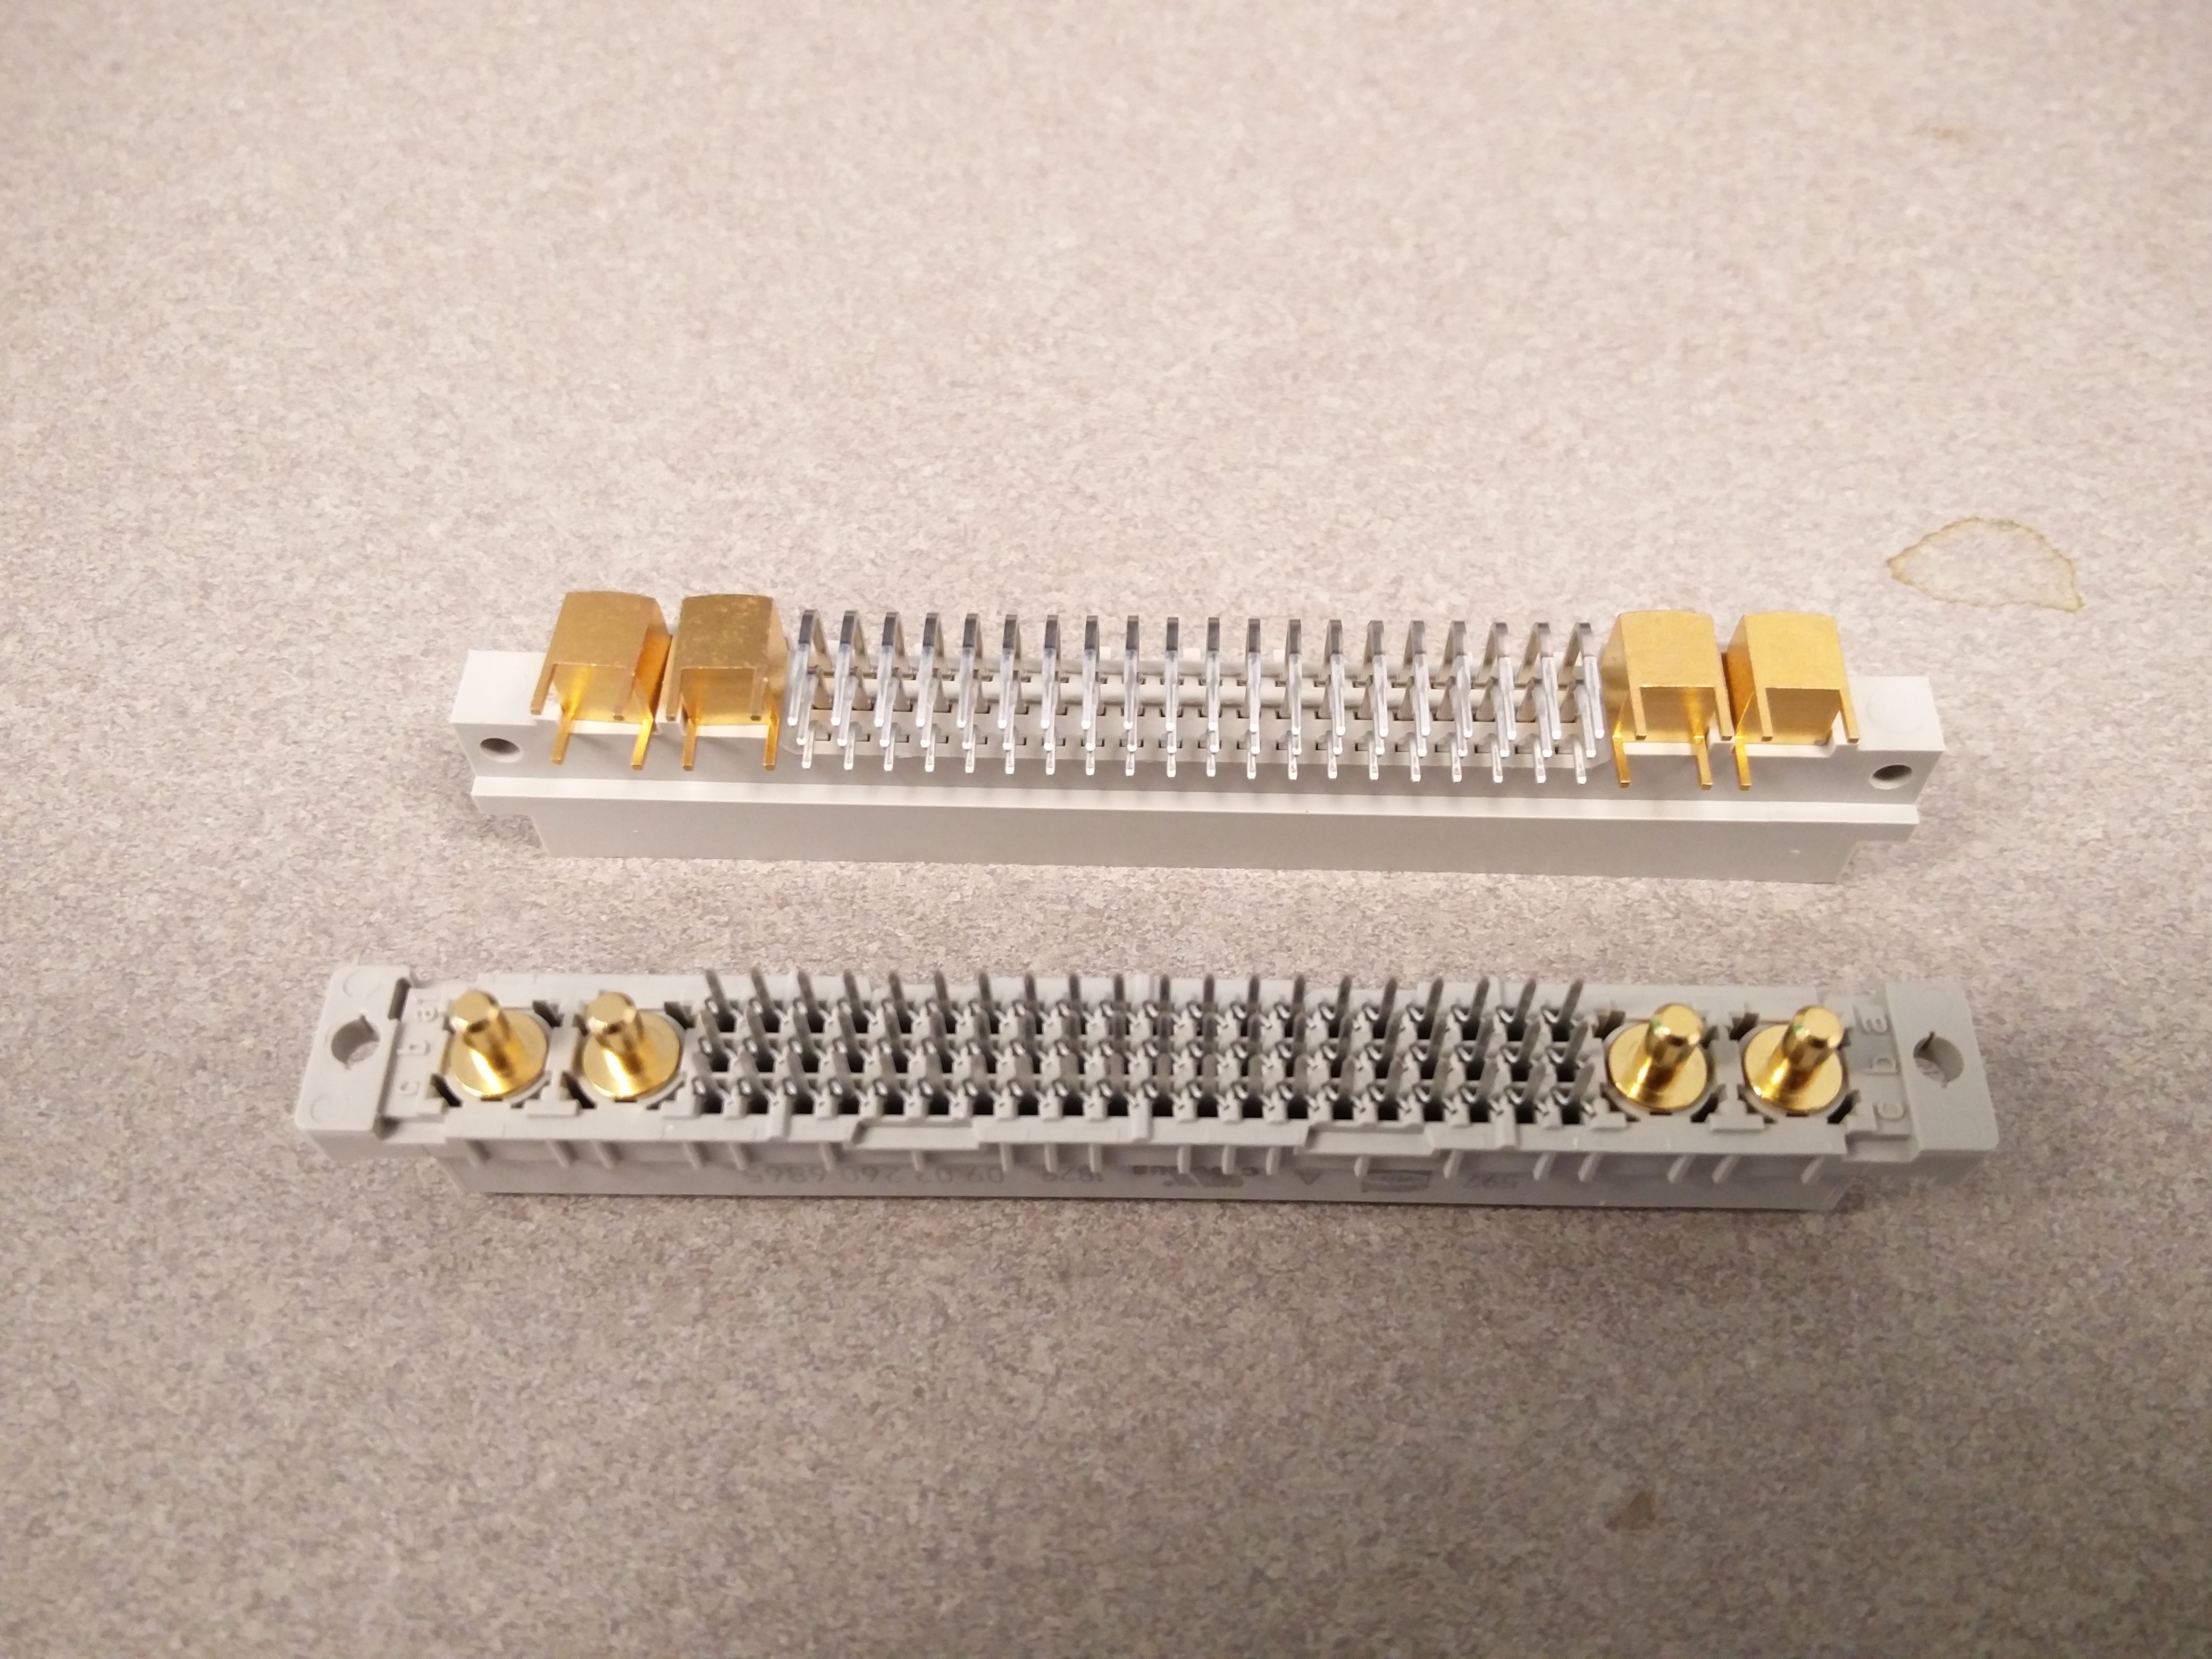
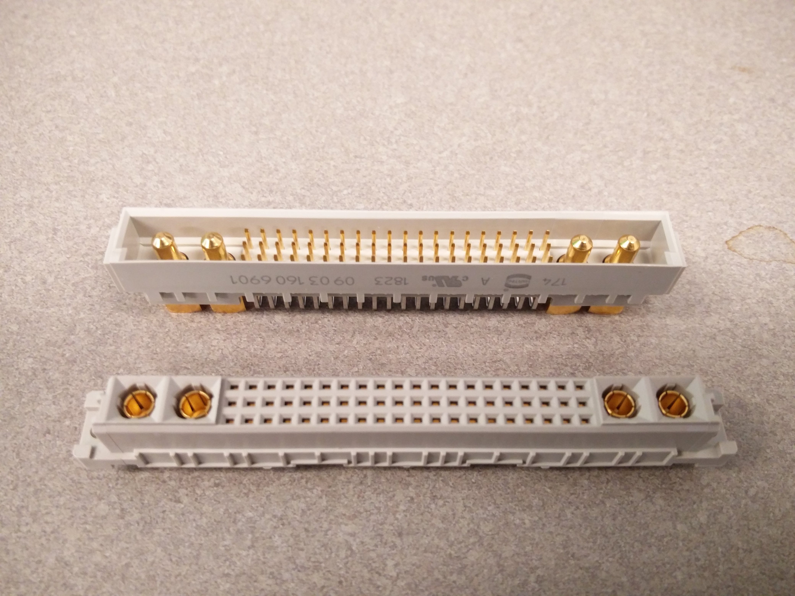
60 Pins @ 2 Amps and 4 High Current Pins @ 20 Amps
Sockets

Slide 7
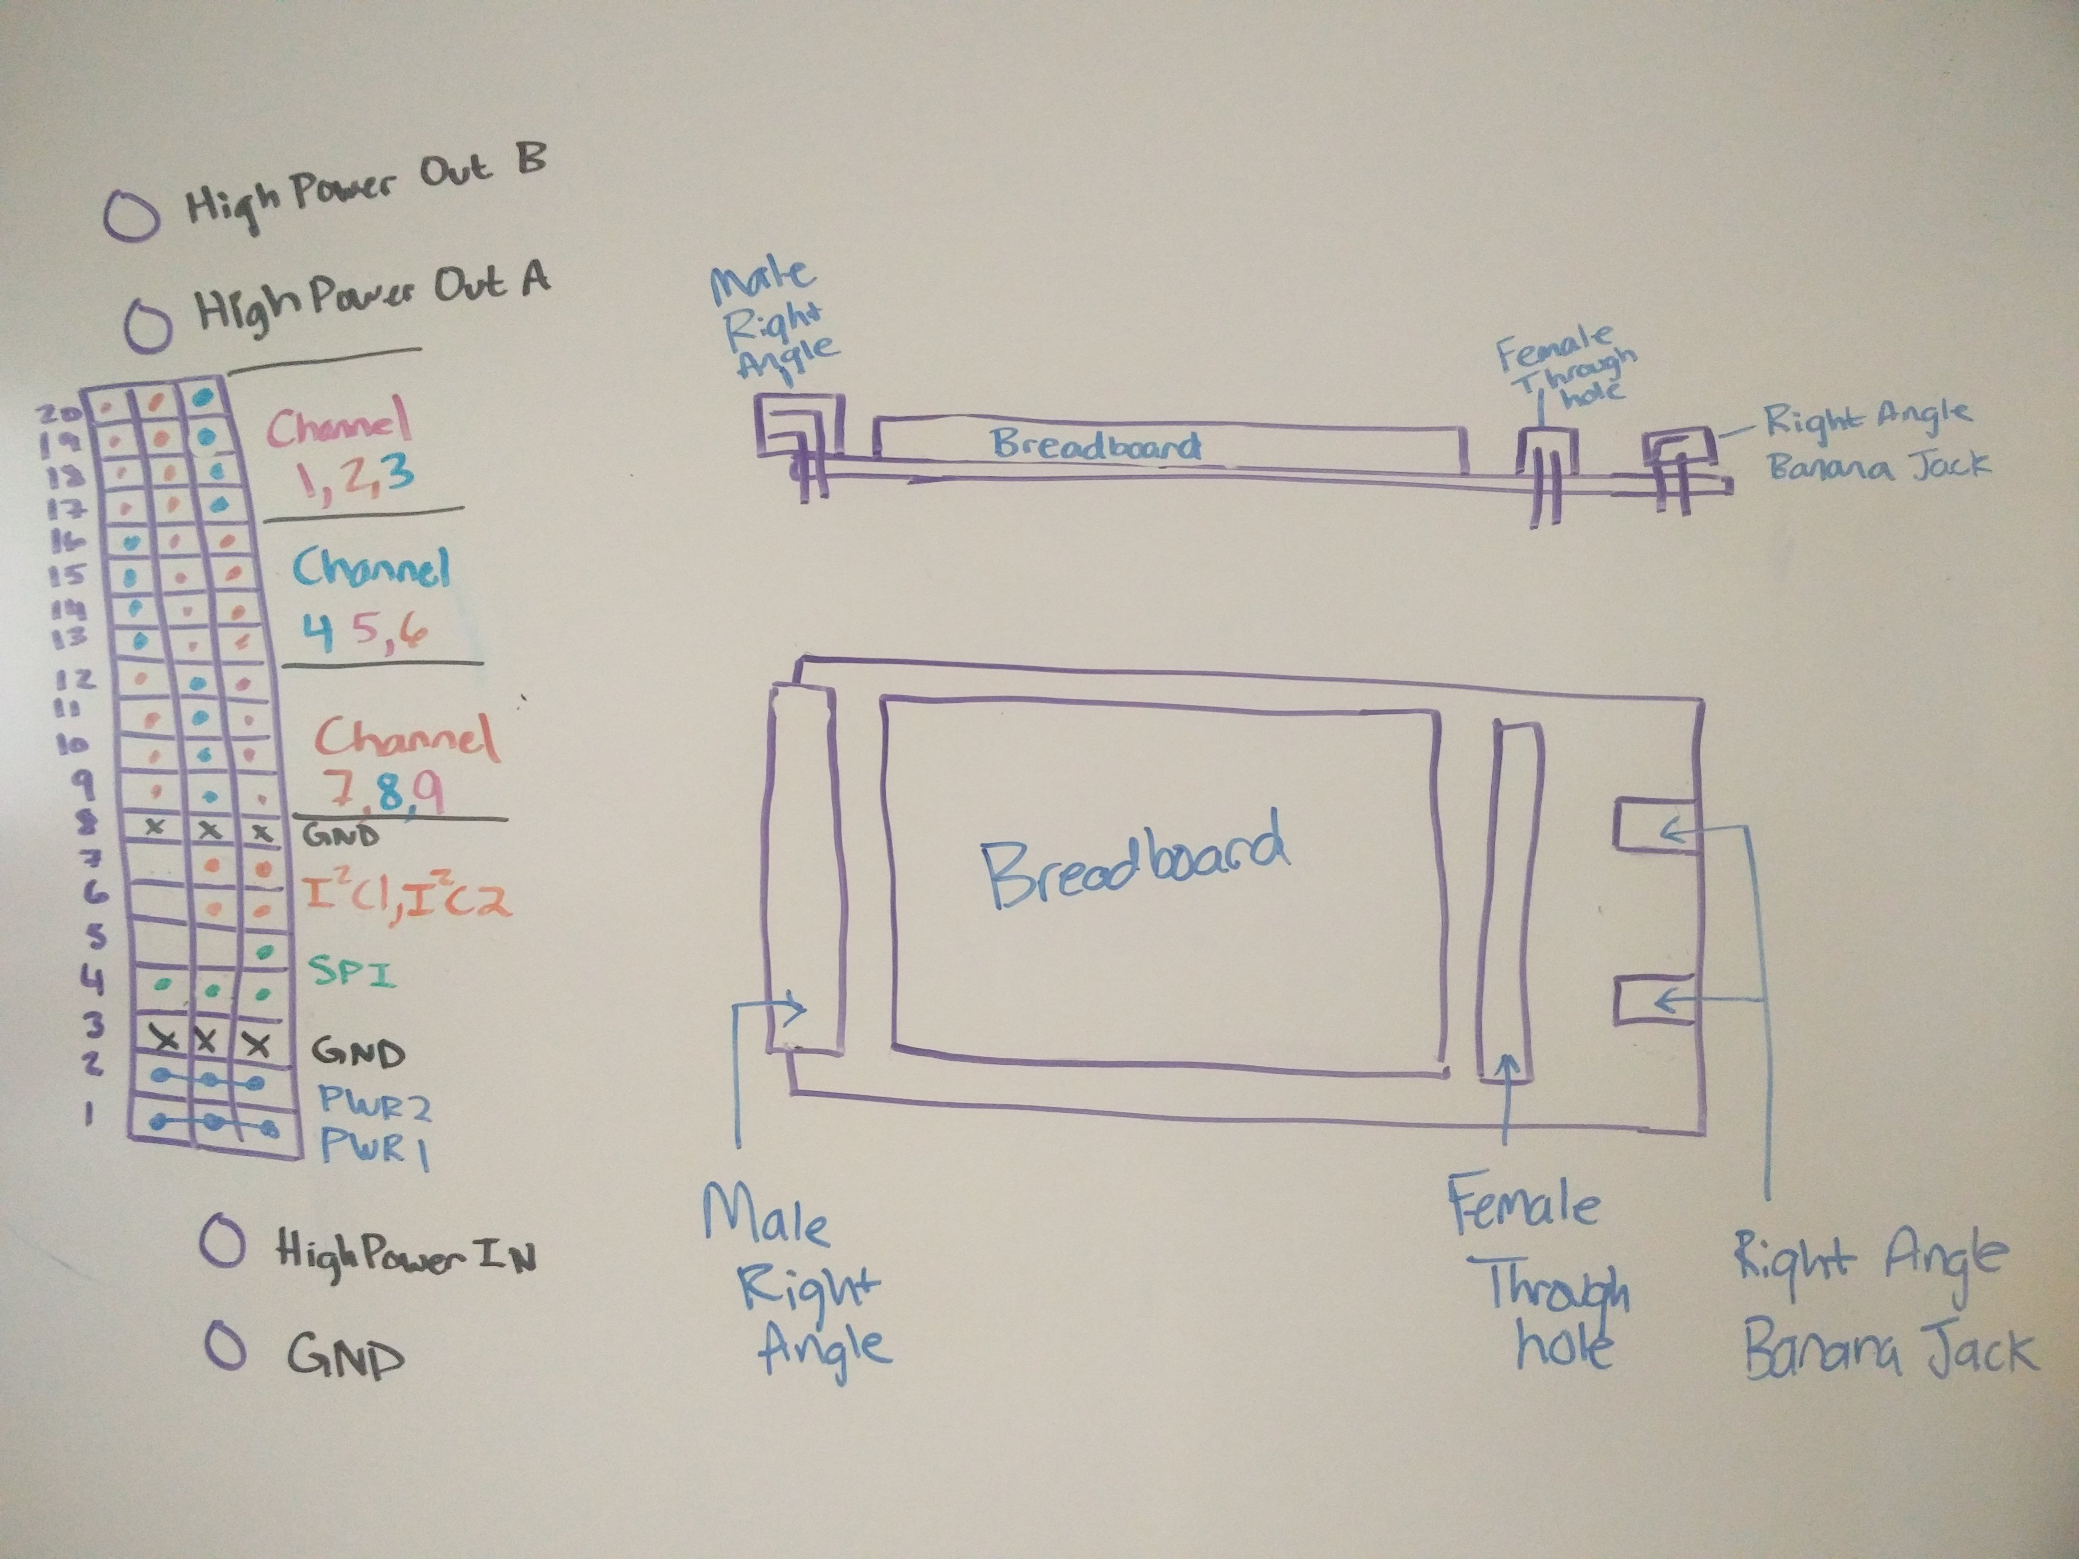
Male Socket, Female Socket, Breadboard, High Power Banana Jacks, Double Length For Easy Access
Prototyping Card (P-Card)
Sketch

Slide 8
Male Socket, Female Socket, Breadboard, High Power Banana Jacks, Double Length For Easy Access
Prototyping Card (P-Card)
Sketch

Slide 9
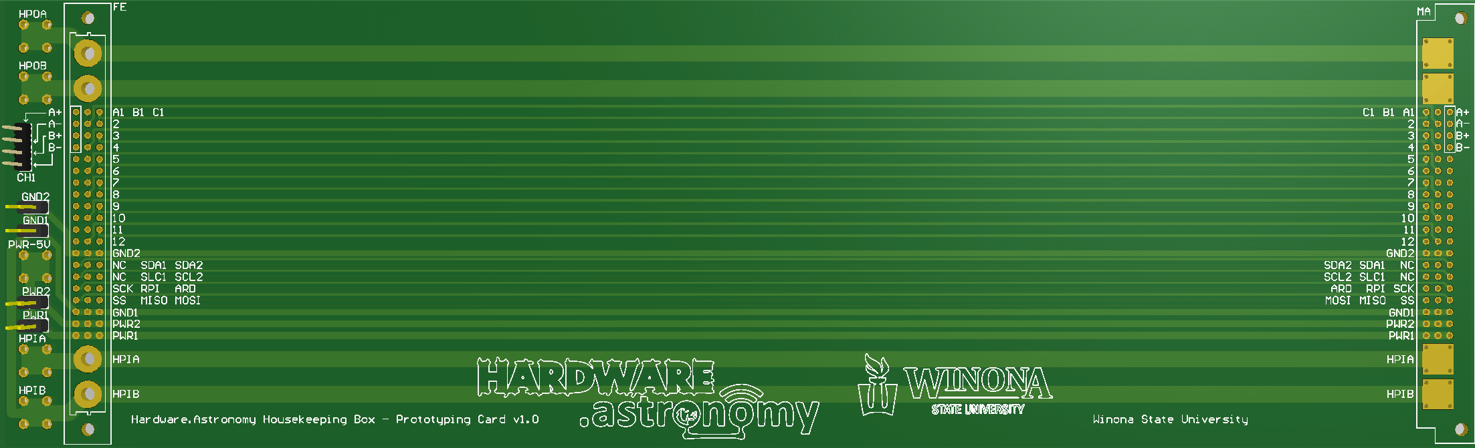
Ground Jumpers
IO Channel
Sockets
High Power Output
High Power Input
Space For
Solderless Breadboard(s)
Low Power Jumpers
P-Card PCB

Slide 10
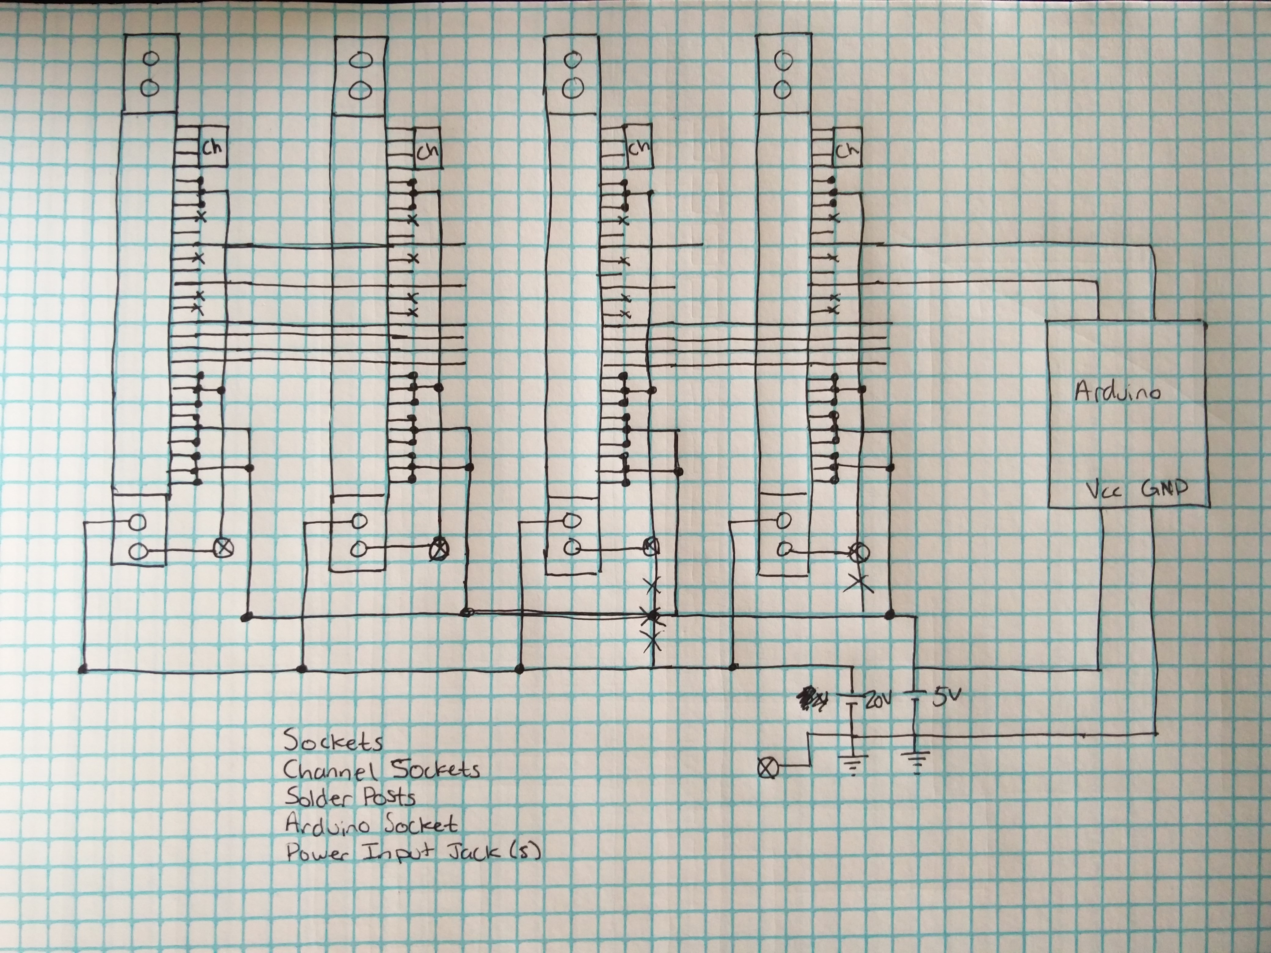
Sockets, Power, SPI, HP Signal I/O, 9 4-pin signal I/Os per card, Arduino Controller (with I2C), On board Temperature Sensors, 7-segment digit display, 5Volt and 20Volt Power, Raspberry Pi (with I2C), Interrupts from Arduino and Pi
Backplane
Simplified
Schematic
Sketch

Slide 11
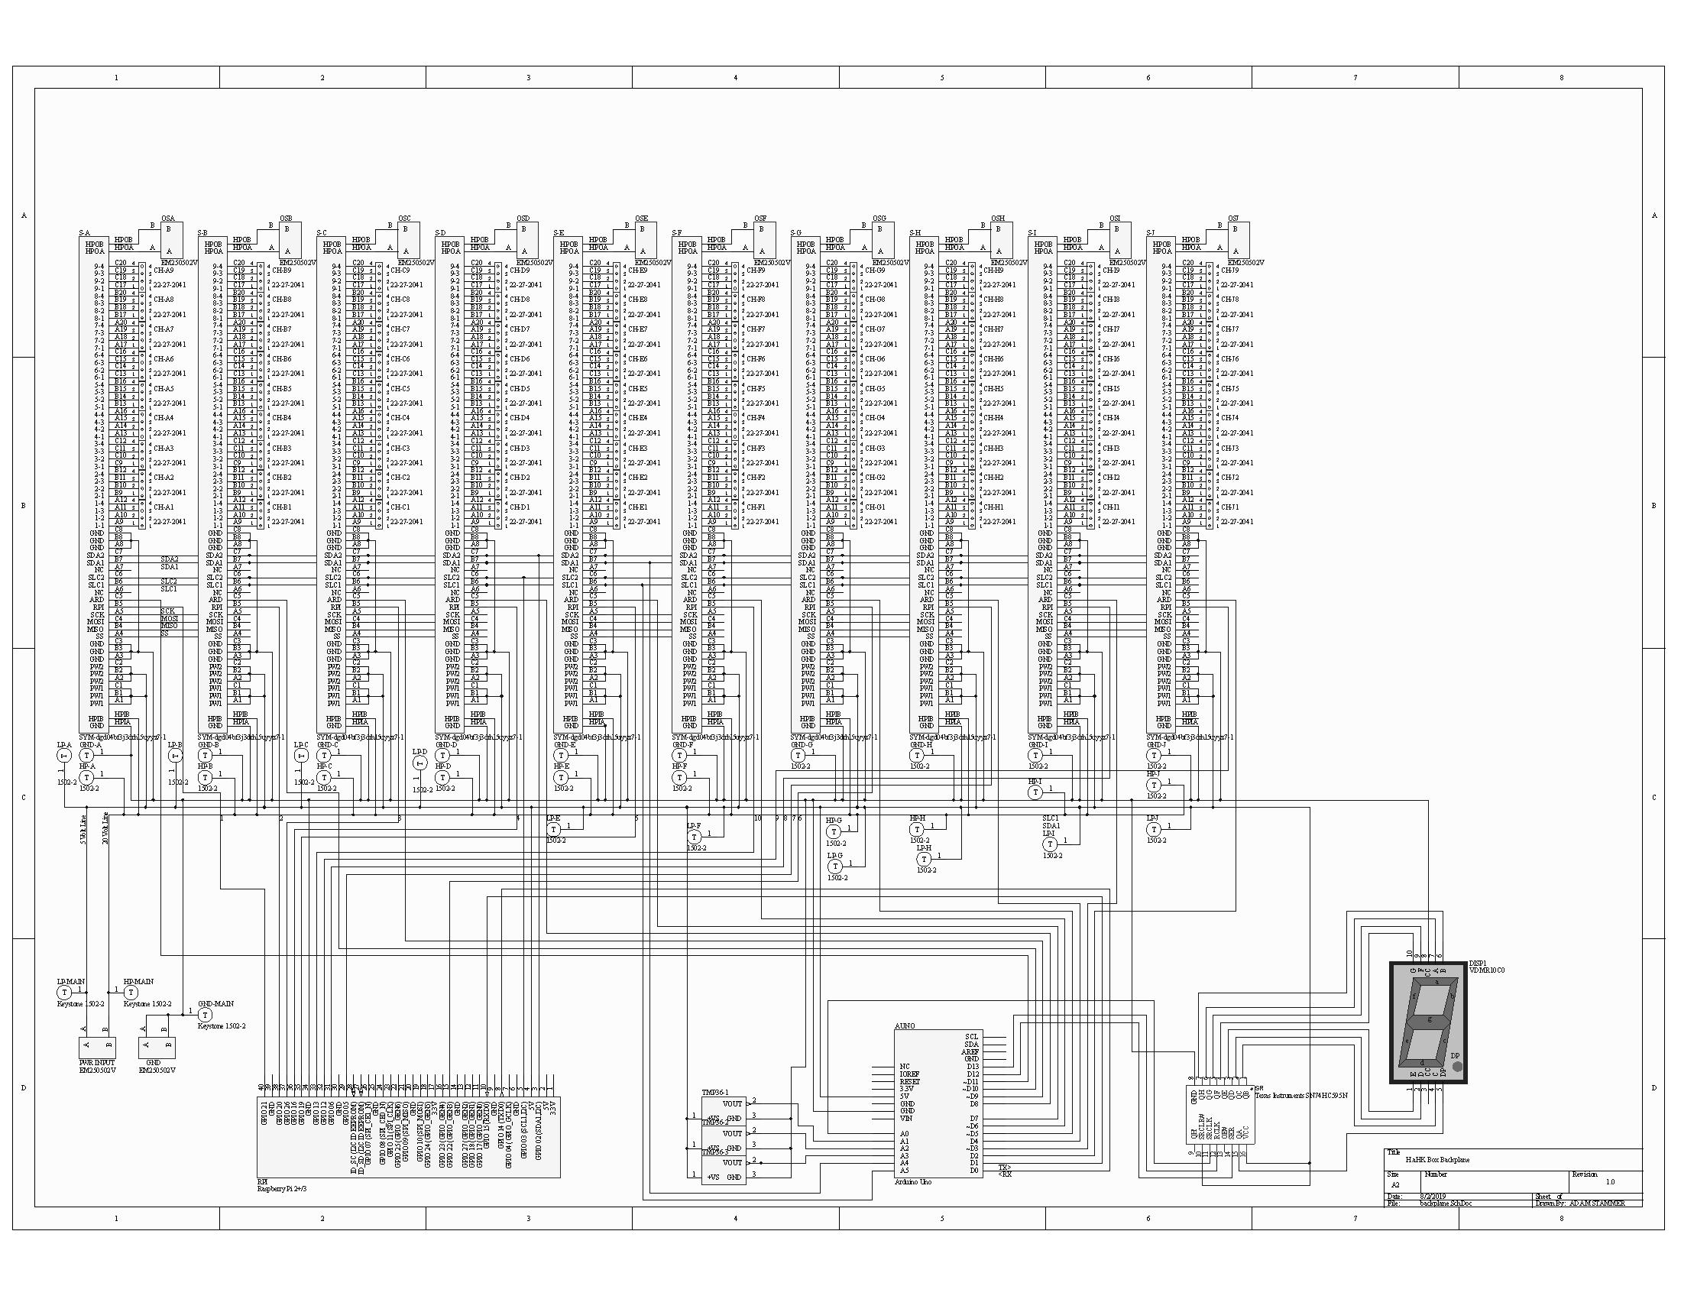
Sockets, Power, SPI, HP Signal I/O, 9 4-pin signal I/Os per card, Arduino Controller (with I2C), On board Temperature Sensors, 7-segment digit display, 5Volt and 20Volt Power, Raspberry Pi (with I2C), Interrupts from Arduino and Pi
Backplane
Schematic

Slide 12

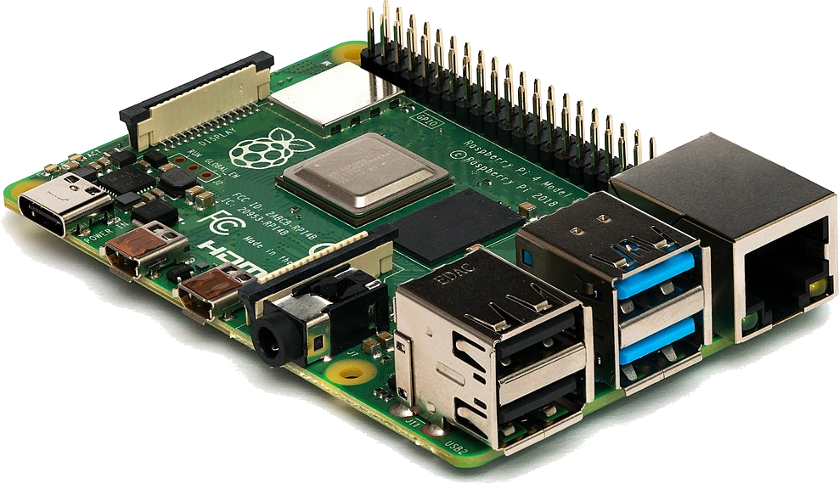

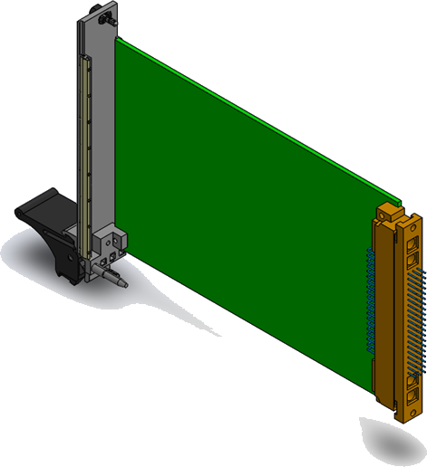
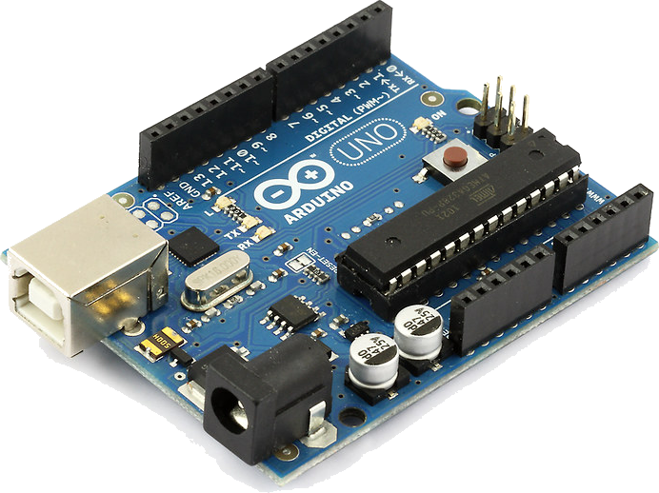

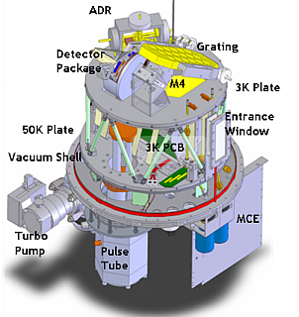

Touchscreen
Raspberry Pi
Microcontrollers
Communication Example
-200°C
Cooler Controller
Arduino
Temperature Sensor
ZEUS2

Slide 13
Finish Technical Guide
Summary of Completed Work
Guide Future Designers and End Users
Finish Backplane PCB Layout
Manufacture
Program Controllers
Capacity Tests
Design/Build Cards
Next Steps

Slide 14
Sources
https://www.circuitbasics.com/
https://www.arduino.cc/
https://www.raspberrypi.org/
https://sites.google.com/site/carlferkinhoff/welcome-1 (thanks Carl)
http://hosting.astro.cornell.edu/~spifiweb/zeus2/index.html

